Slide 1

Anti-cafes, Co-workings, Hackerspaces in Russia: Audiences, Activities, and Interests
Gleb Suvorov
Teplitsa of Social Technologies
GARAGES, KITCHENS, & HACKERSPACES: THE SPACES AND NARRATIVES OF THE NEW INNOVATION, 2014

Slide 2
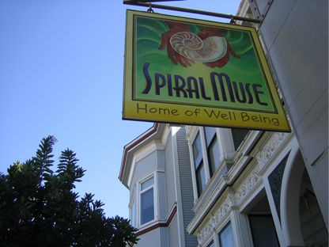
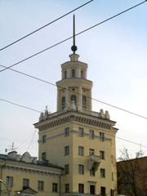
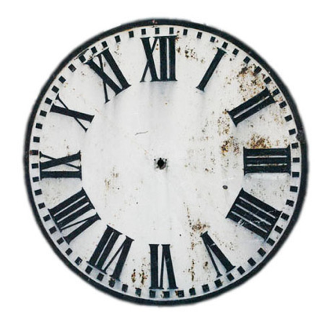


History
2005, San Francisco Coworking Space
2008, Tower, Yekaterinburg
2011, Ziferblat, Moscow
$4-$8 в час

Slide 3
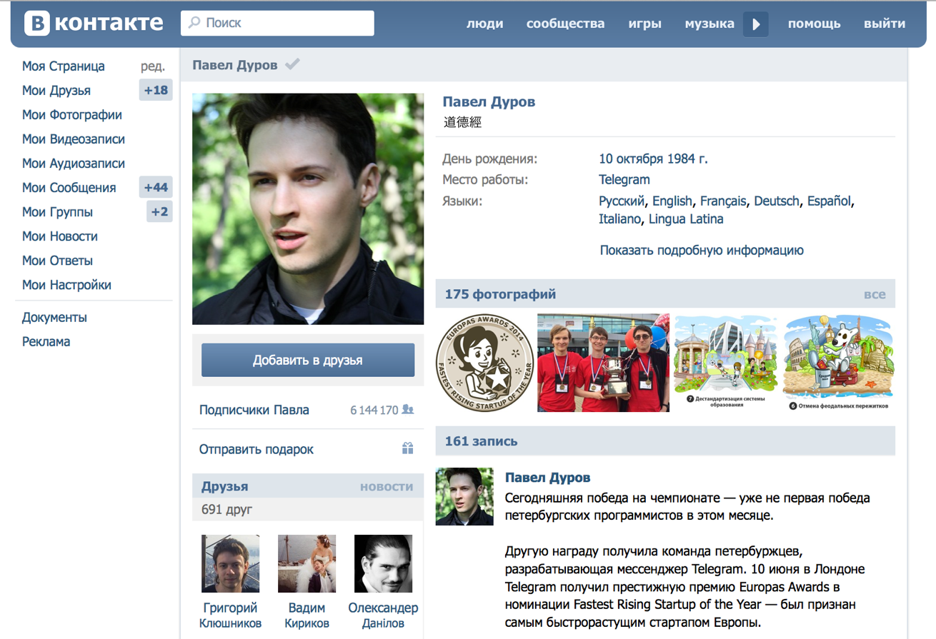
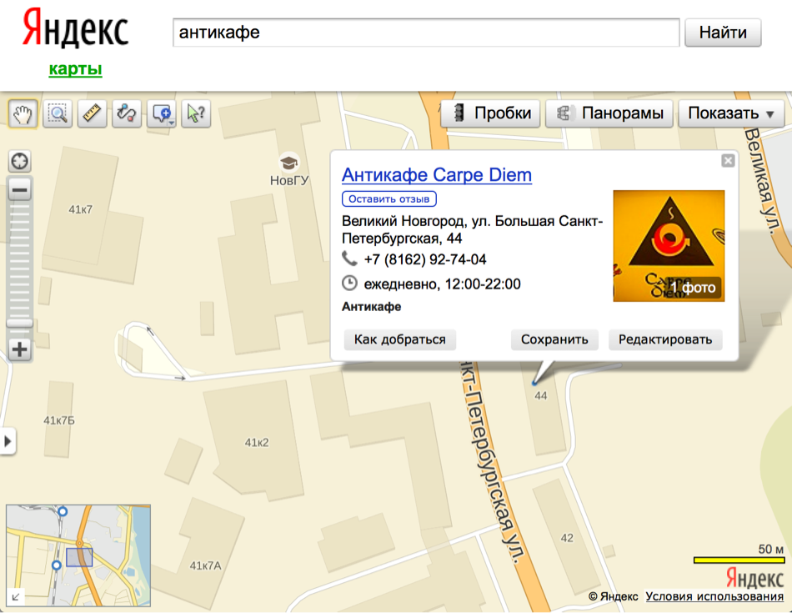
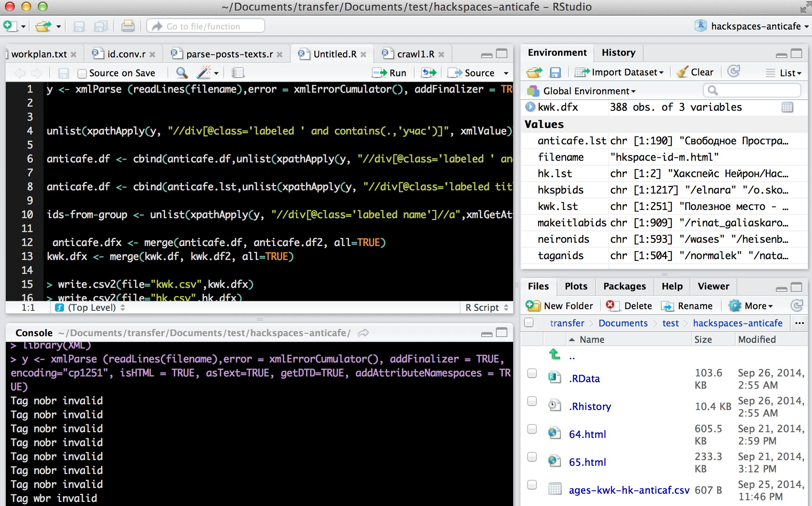
The Data

Slide 4


Russia 2014
Anticafes (811 groups)
total alive - 300
Moscow - 90
St.-Petersburg - 38
Co-workings (388 groups)
total alive - 100
Moscow - 20
St.-Petersburg - 8
Hackerspaces about 20

Slide 5
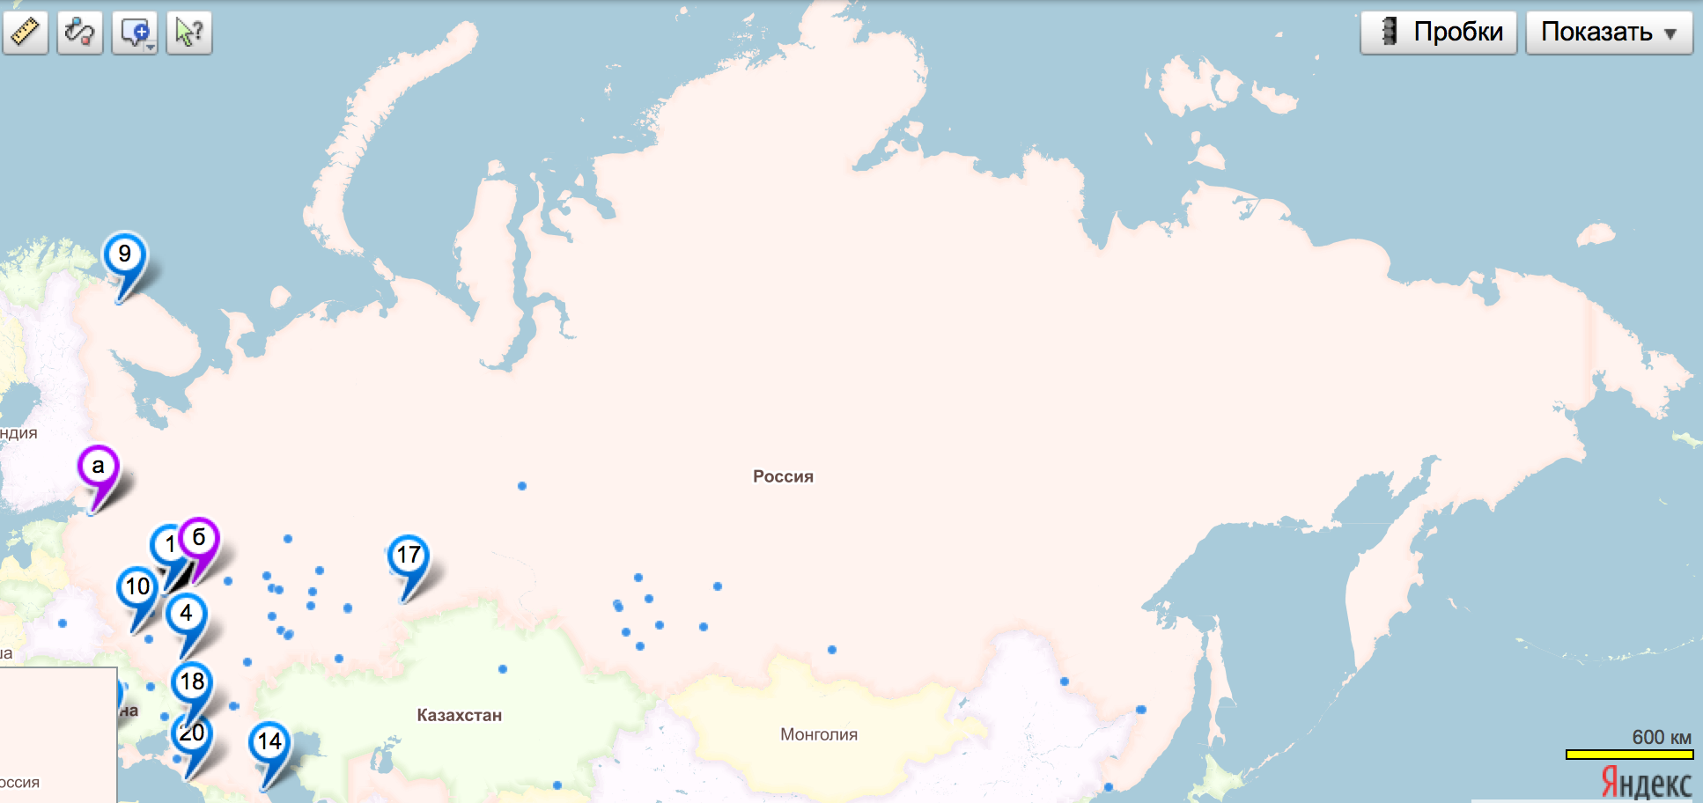
Geography
20% in Moscow

Slide 6
Numbers
Anticafes 800 000 fans
Co-workings 80 000 fans
Hackerspaces 4400 fans
e.g. about 1% of active population might be involved

Slide 7
Sex ratio

Slide 8
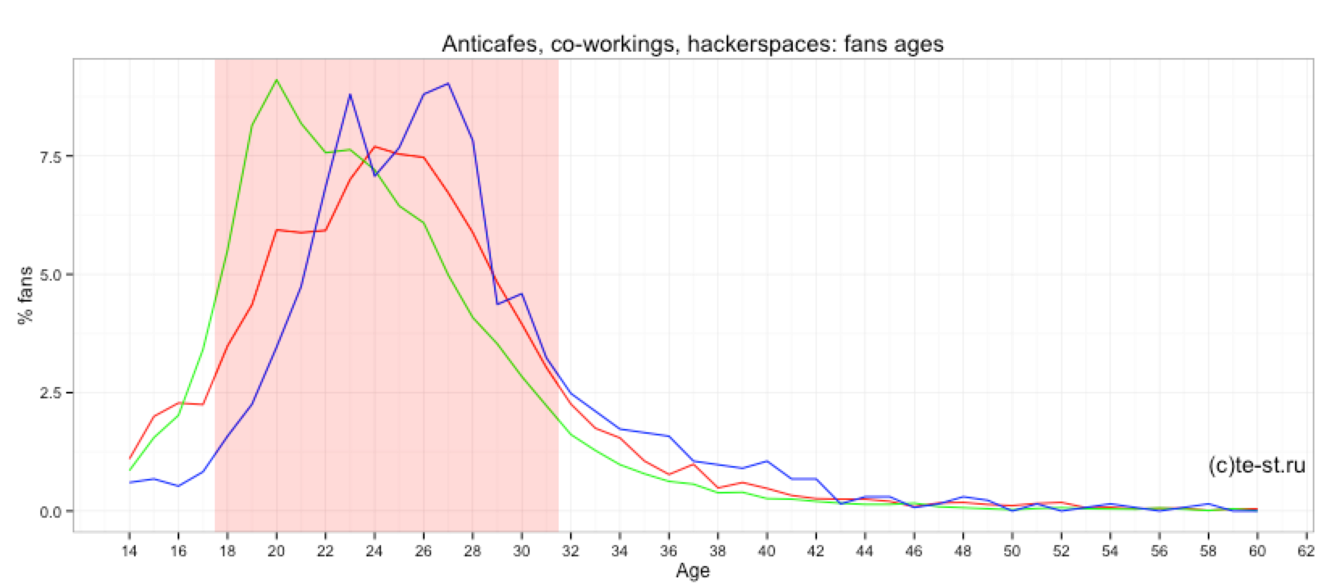
Age
Anticafes: Females, 20
Co-workings: 24
Hackerspaces: Males, 28

Slide 9

Interests
Music
Psychology
Tourism
Photography
movies
Coding
sport
electronics
books
Mathematica
snowboarding
IT
business
bikes
family
Philosophy
Linux

Slide 10
Music
Сплин
Metallica
NA
Алиса
Apocalyptica
Bob Marley
Dangerkids
MC 1.8
Без названия
Nina Simone
Rammstein
Аквариум
Satyricon
Skillet
The Beatles
David Garrett
Death From Above 1979
25/17
Oasis
The Jackson 5
Ленинград
Ляпис Трубецкой
Неизвестен
Led Zeppelin
Гражданская Оборона
Земфира
Нейромонах Феофан
Самое Большое Простое Число
AC/DC
Arctic Monkeys
Disturbed
Leonard Cohen
Ludovico Einaudi
Aphex Twin
Boston
Brock Berrigan
Destiny's Child
Flёur
Guns N' Roses
In Flames

Slide 11
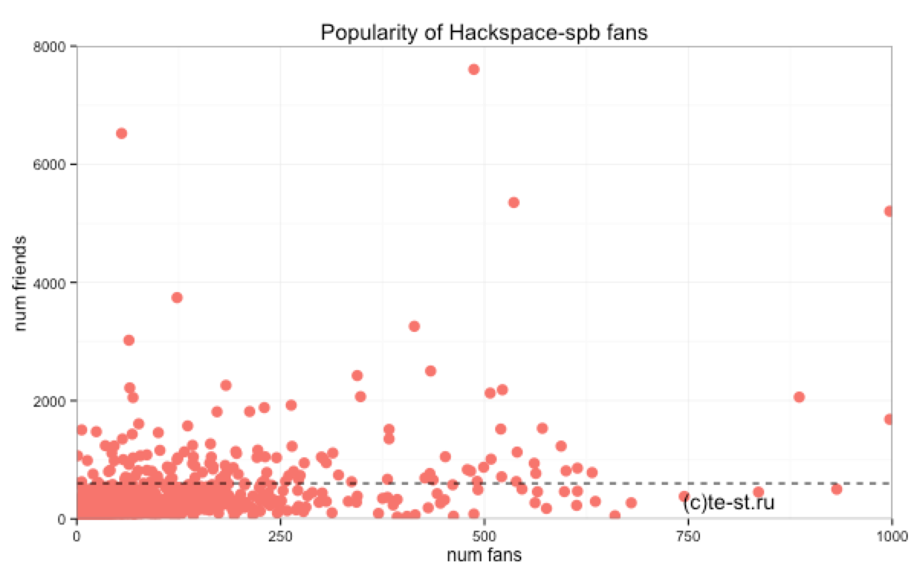
Friends

Slide 12
Social networks
the big impressive image of backspace spb social network to be placed here

